Slide 1
Fund Balance Projection as of March 10, 2025 2024-2025 School Year
Board of Education Presentation
March 12, 2025

Slide 2
Why a Fund Balance Projection?
Deficit or Surplus
Do we have the funds to appropriate?
Can we transfer surplus to fund reserves?
Long-range planning
Financial health & stability
Cover unanticipated deficits
Compliance with NYS OSC & NYSED

Slide 3
Fund Balance – 4 Classifications:
Restricted Fund Balance – Reserve accounts
Assigned Appropriated FB – funds set-aside to fund next year’s budget
Unassigned Appropriated FB – purchase orders carried over into the next school year
Unassigned Unappropriated FB – undesignated, remaining funds
NYS Office of Comptroller – 4% of next year’s budget

Slide 4
Fund Balance Projection Calculation 6/30/25
6/30/24 Unassigned Unappropriated FB $ 1,989,971
PLUS
24/25 Assigned Appropriated FB $ 921,815
24/25 Assigned Unappropriated FB $ 145,942
Projected Revenues *
(94.64% of Budget) $23,702,990
*No Reserves applied to Revenues

Slide 5
Fund Balance Projection Calculation 6/30/25
LESS
Projected Expenditures $23,602,856
(94.79% of Budget)
25/26 Assigned Appropriated FB $ 921,815
25/26 Assigned Unappropriated FB (Projected) $ 150,000
6/30/25 Unassigned Unappropriated FB $ 2,086,048
Projected

Slide 6
Reserve Transfer Recommendations
LESS Transfer to Restricted Fund Balance:
Repair Reserve, $600,000
(Not to Exceed, voter approval required)
Capital Reserve for Bus Purchases, $500,000
(Maximum deposit)
Liability & Property Loss Reserve, $35,000
6/30/25 Unassigned Unappropriated Fund Balance,
$2,086,048
% of the 2025/2026 Budget^, 8.31%
When District has Surpluses, transfer to reserve as per Reserve Plan guidance
^Using $25,100,000 for the 2025/2026 Budget.
Per §1318 of the Real Property Tax Law, 4% of next year’s budget
Total Reserve Transfer Recommendation, $1,135,000

Slide 7
Fund Balance Projection Calculation 6/30/25
6/30/25 Unassigned Unappropriated FB $ 2,086,048
Projected
PLUS Transfer out of Reserve $ 57,000
(EBALR for sick time payouts at retirement)
LESS
Transfer to Restricted FB (3 Reserves) $ 1,135,000
6/30/25 Unassigned Unappropriated FB $ 1,008,048
Projected

Slide 8
Fund Balance Scenarios
NOTE: FB amount/percent over the 4% based on the 2025/2026 Budget at $25,100,000.
Where does Unassigned Unappropriated FB goes? (EBLAR Reserve Transfer In applied) | Unassigned Unappropriated FB Amount | Unassigned Unappropriated FB % goes to | Amount over the 4%
With No Reserve Transfers | $ 2,143,048 | 8.54% | $1,139,048
Repair Reserve Transfer only | $ 1,543,048 | 6.15% | $ 539,048
Capital Reserve Transfer only | $ 1,643,048 | 6.55% | $ 639,048
Repair & Capital Reserve Transfer | $ 1,043,048 | 4.16% | $ 39,048
With Repair, Capital, & Liab/Prop Reserve Transfer | $ 1,008,048 | 4.02% | $ 4,048

Slide 9
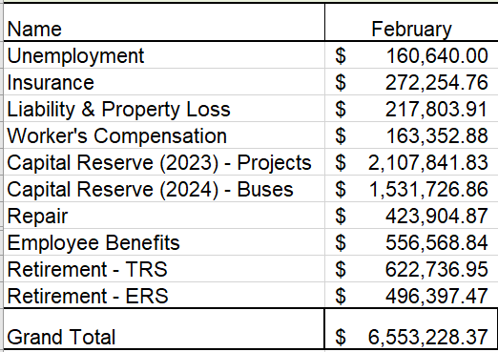
Appropriating Reserves
We will appropriate Reserve(s) as Revenues for the 2025/2026 budget:
Worker’s Comp. Reserve – to offset Insurance premium, $40,184
(24/25 year District appropriated $55,631)
ERS Retirement Reserve – to offset Retirement contributions, $100,000
(24/25 year District appropriated $72,183)
TRS Retirement Reserve – to offset Retirement contributions, $100,000
(24/25 year District appropriated $100,000)
*Will appropriate more as needed from the ERS and/or TRS Reserve to fill the budget gap.*
Restricted Fund Balance (Reserves) Breakdown:

