Slide 1
Budget Workshop #3 Budget & Revenues Update 2025-2026 School Year
Board of Education Presentation
March 12, 2025

Slide 2
Budget Workshop Agenda
Budget Updates
Program Component
2025/2026 Preliminary Budget as of 3/12/25
2025/2026 Estimated Revenues as of 3/12/25
Overall 2025/2026 Budget Status
Voter Propositions for Consideration
Budget Development Timeline

Slide 3
2025/2026 Budget Updates
Changes & Impact to Overall Preliminary Budget:
Salaries & Benefits adjusted to reflect ongoing retirements & replacements (or attrition)
Tuition – updated based on private/public placements (incl. BOCES)
Most BOCES Rates updated
Materials & Supplies updated
Software/Subscriptions – some but not all

Slide 4
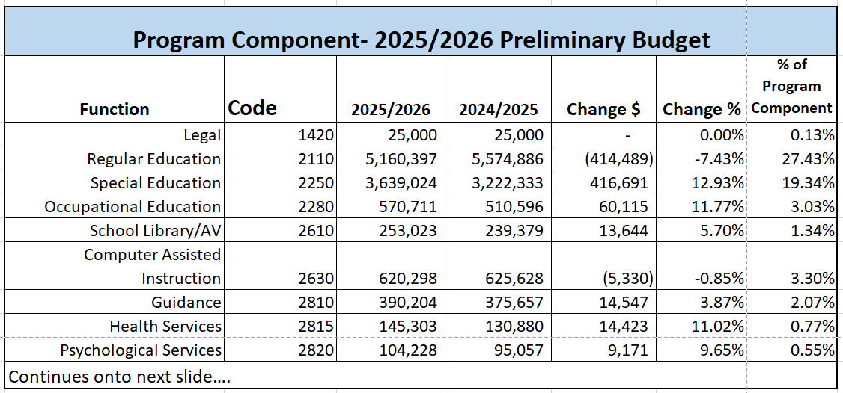
2025/2026 Program Budget as of 3/12/2025

Slide 5
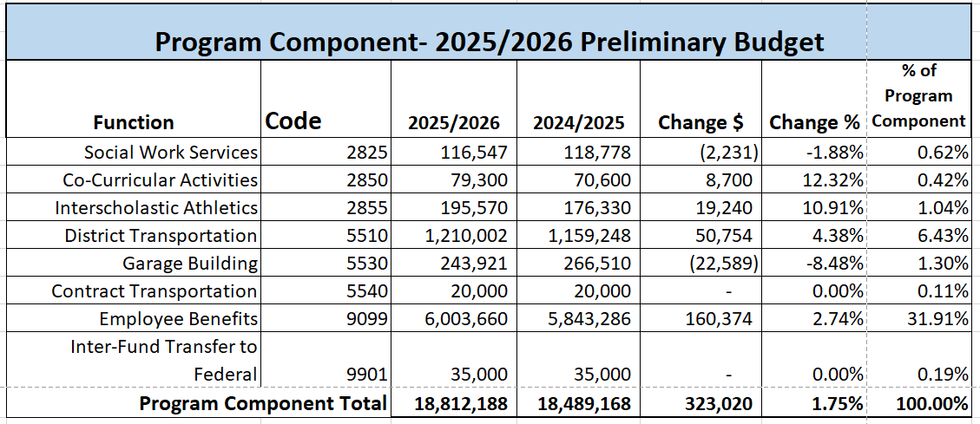
2025/2026 Program Budget as of 3/12/2025
Program Budget $18,812,188
Increase of +$323,020, or +1.75%

Slide 6
2025/2026 Prelim. Budget as of 3/12/2025
Overall Budget $25,139,180
Increase of +$239,180, or +0.96%

Slide 7
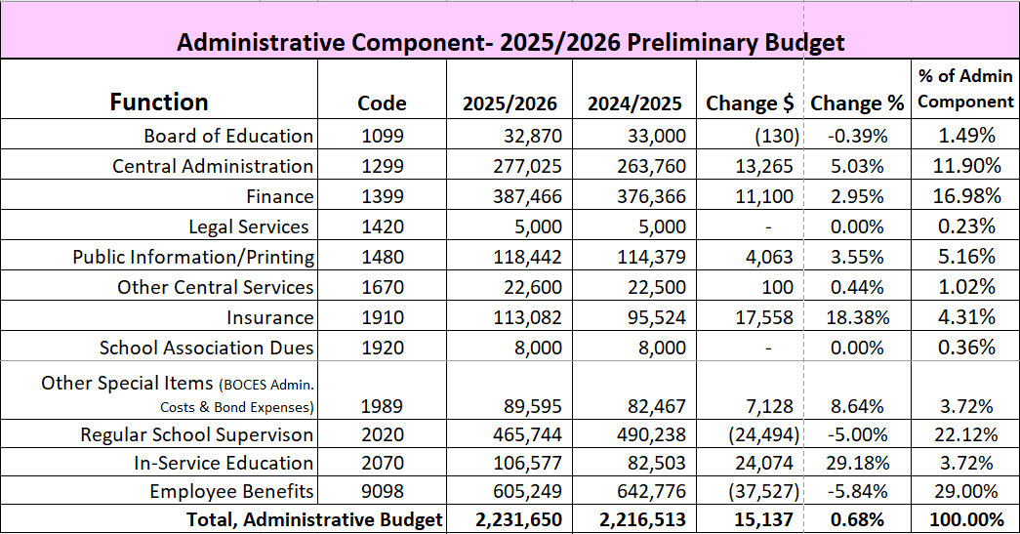
2025/2026 Prelim. Budget as of 3/12/2025
Admin Budget $2,231,650
Increase of +$15,137, or +0.68%

Slide 8
2025/2026 Prelim. Budget as of 3/12/2025
Capital Budget $4,095,342 Decrease of -$98,977, or -2.36%

Slide 9
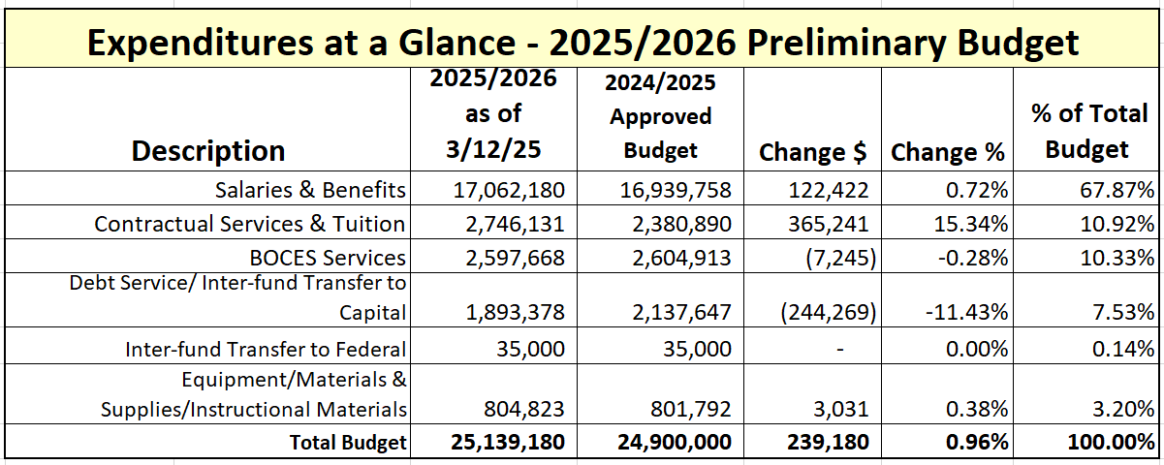
2025/2026 Prelim. Budget as of 3/12/2025
NOTE: Rollover budget was $25,456,046 (a decrease of -$316,866)

Slide 10
School Tax Levy/Property Tax Cap Information
2025/2026 Proposed Tax Levy Increase of 1.50% (+$156,144)
Past 6 years under the maximum allowable amount
Maximum tax levy amount dependent on tax cap calculation

Slide 11
Middleburgh Meadows PILOT
15 Year PILOT agreement – 25/26 is Year 9
Formula-driven; can vary slightly each year but actual amount determined by number of unoccupied units ready for sale
$2,000 per unit for each unit “constructed but not sold”
Part of the Property Tax Cap Calculation (reduces allowable amount)
Once units are sold, become part of school tax base / no longer part of the PILOT calculation.
The more built but remain unsold, the greater the PILOT amount.
Payments made past two years plus estimated:
23/24: $19,110 (year 7 – estimated 3 units, actual 6 units)
24/25: $15,697 (year 8 – estimated 6 units, actual 2 units)
25/26: $16,653 (year 9 – estimating 2* units)
*anticipated per Schoharie County IDA

Slide 12
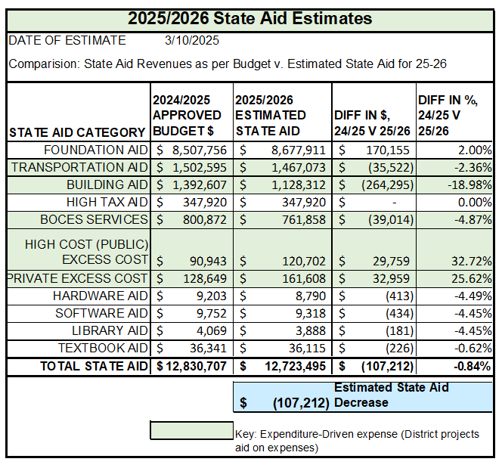
2025/2026 Estimated State Aid as of 3/12/2025
$12,723,495
Decrease of -$107,212, or -0.84%
2% Foundation Aid Increase
Building Aid reduction due to falling debt (paid off 2010 Serial Bond)
PLUS Medicaid (Federal Aid), $60,000

Slide 13
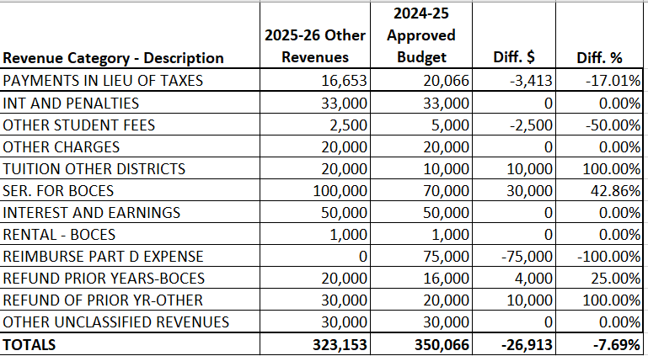
2025/2026 Other Revenues as of 3/12/2025
Decrease of -$26,913, or -7.69%
No more Medicare Part D reimbursement with MAP plan
Less units in PILOT calculation
Anticipate more revenues for services

Slide 14
2025/2026 Other Revenues as of 3/12/2025
Increase of $12,370, or +0.99%
WC Reserve – to cover cost of annual insurance premium
TRS & ERS Reserves – offset part of cost for NYS retirement pensions

Slide 15
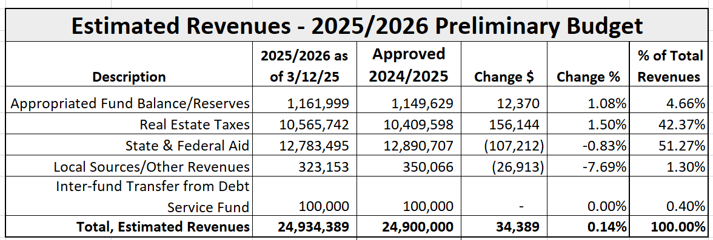
2025/2026 Estimated Revenues as of 3/12/2025
Overall Revenues, $24,934,389
Increase of +$34,389, or +0.14%

Slide 16
Current 2025/2026 Budget Outlook
2024/2025
Approved Budget $24,900,000
Preliminary Budget, $25,139,180 (+$239,180)
--------
Estimated Revenues*, $24,934,389 (+$ 34,389)
Budget Shortfall, -$ 204,791 as of March 12, 2025
Reduce budget to $25,100,000 (-$39,180) → Budget Shortfall goes to -$165,611
Appropriate more Reserve funding
ERS Reserve, +$65,611
TRS Reserve, +$100,000

Slide 17
Voter Propositions for Consideration
School Bus Purchase - Total cost not to exceed $484,000
As per Bus Replacement Plan – diesel engine buses
2-65 passenger buses with Luggage Compartments
1-30 passenger Wheelchair bus
Capital Project/Capital Reserve Proposition
$8.1 Million total project cost – Reserve balance as of 2/28/2025, $2,107,842
Withdrawal $2M from 2023 Capital Reserve for no additional tax impact
Ability to continue funding reserve for next project after withdrawal (additional $2M through 2033)
Anticipate a capital project every 5 years to maintain/upgrade buildings & grounds
Repair Reserve Transfer
Per Reserve/Fund Balance plan - Reserve balance as of 2/28/2025, $423,905
Transfer $ not to exceed $600,000 (voter approval required/actual amount TBD by BOE)
Funds set-aside for one-time unanticipated repair expenditures

Slide 18
Budget Development Calendar 2025/2026
Meeting Date | Topic | Agenda Details
March 12th | Budget Workshop #3 | Estimated Revenues Program Component Preliminary Budget & scenarios (if applicable) Fund Balance Projection for 6/30/25
April 9th | Budget Workshop #4 | Review Proposed Budget & Estimated Revenues Approve Tentative Budget & Proposition(s) for Voter approval
April 21st | Deadline to file Proposition/ Petition(s) | Due to District Clerk by 5 pm (2 BOE seats expire 6/30/2025)
April 23rd | BOCES Annual Vote & Tentative Budget/proposition(s) Vote* *If vote not completed on the April 9th BOE Meeting
May 7th ^{Public Hearing} | Annual Budget Hearing/BOE Election Information (at the BOE meeting)
May 20th ^{12 pm – 9 pm} | Annual Budget/Proposition Vote & BOE Election

